Slide 1


TECHZONE
RETAIL STORE
NETWORK PLAN

Slide 2

BUSINESS OVERVIEW
TechZone is a three-story retail establishment specializing in selling the latest gadgets, accessories, and providing computer services. The store needs a robust and reliable network to support its point-of-sale (POS) systems, inventory management, customer Wi-Fi, and computer service operations.
The network will support all essential business activities, ensuring smooth operations and excellent customer service across its three floors.

Slide 3
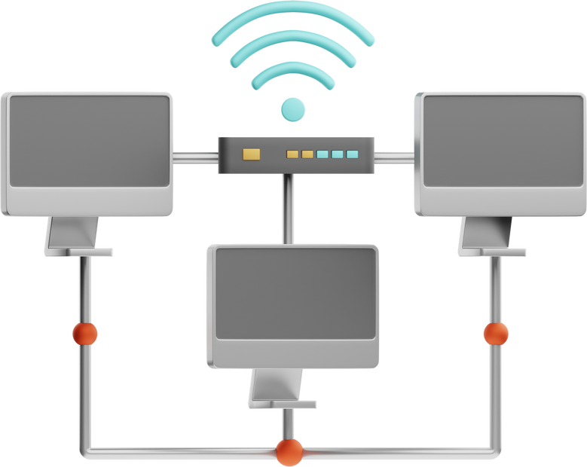
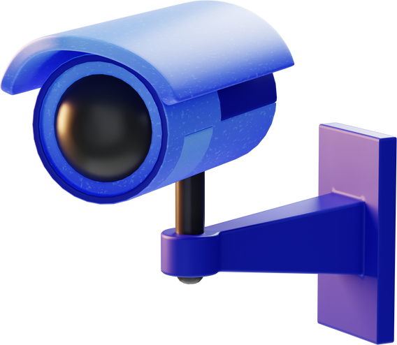

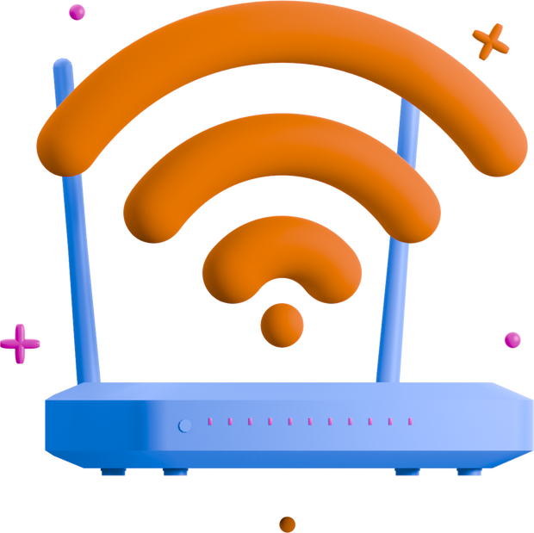
REQUIREMENTS
Stable wired connections
IP surveillance
Segmentation of the network
Wireless connectivity

Slide 4
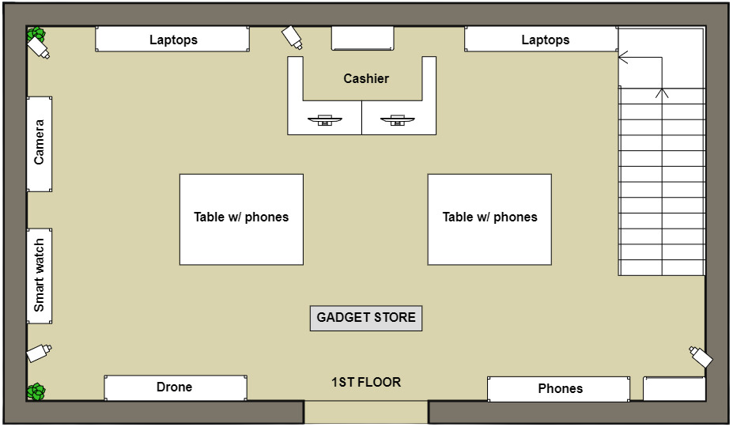
FLOOR PLAN
1ST FLOOR (Gadget Store)
POS Systems - wired connections for all checkout counters.
Staff Devices - wireless access for tablets and inventory management devices used by staff.
Customer Wi-Fi - a dedicated wireless network for customer access.
Surveillance Cameras - wired IP cameras for monitoring the shop area.

Slide 5
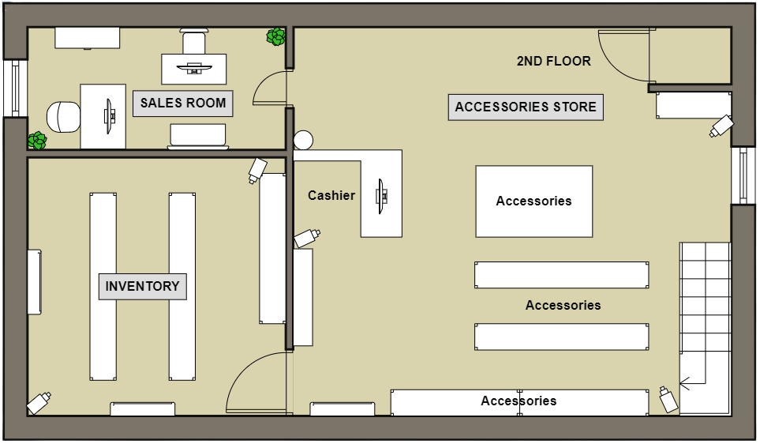
FLOOR PLAN
2ND FLOOR (Accessories Store)
POS Systems - wired connections for additional checkout counters.
Sales Room - wired and wireless connections to handle customer inquiries, financial transactions, and access to inventory databases.
Staff Devices - wireless access for staff to manage inventory and assist customers.
Customer Wi-Fi - wireless network available for customers.
Surveillance Cameras - wired IP cameras to monitor the accessories area.

Slide 6
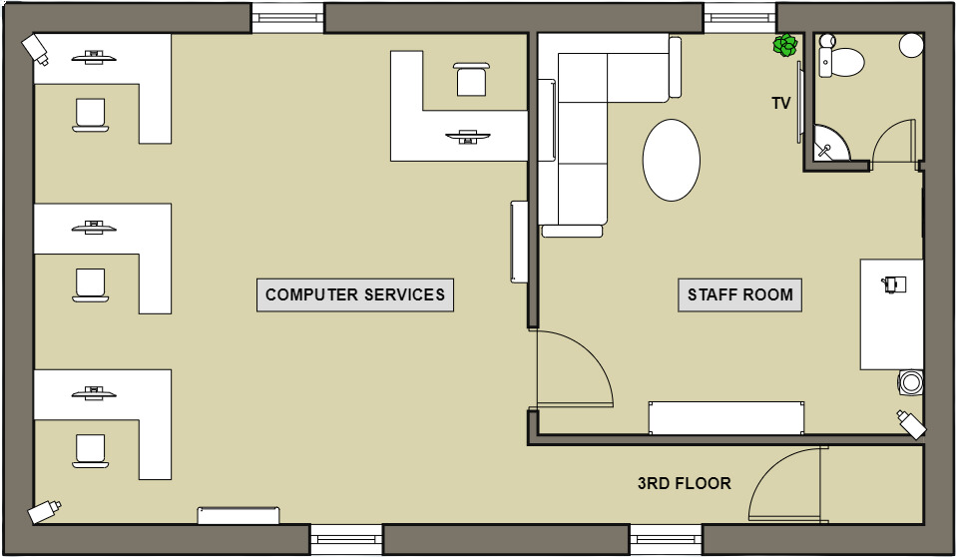
FLOOR PLAN
3RD FLOOR (Computer Services)
Workstations - wired connections for service desks and computers used for repairs and customer consultations.
Staff Personal Devices - wireless access for staff personal devices.
Customer Wi-Fi - wireless network available for customers.
Wireless Network - wireless access for technicians using tablets.
Surveillance Cameras - wired connections for monitoring service areas.

Slide 7
IP ADDRESS TABLE
1ST FLOOR
DEVICES | VLAN | NETWORK ADDRESS | IP ADDRESS RANGE | SUBNET MASK
2 POS System, Staff PCs, Wireless Router (Staff) | VLAN 10 | 192.168.10.0/24 | 192.168.10.10 – 192.168.10.50 | 255.255.255.0
Wireless Router (Customer), Customer Wi-Fi Devices | VLAN 40 | 192.168.40.0/24 | 192.168.40.10 - 192.168.40.50 | 255.255.255.0
CCTV Monitoring PC, Security Cameras (Wired) | VLAN 50 | 192.168.50.0/24 | 192.168.50.10 - 192.168.50.50 | 255.255.255.0

Slide 8
IP ADDRESS TABLE
2ND FLOOR
DEVICES | VLAN | NETWORK ADDRESS | IP ADDRESS RANGE | SUBNET MASK
Sales PCs, Wireless Router (Staff), POS Systems | VLAN 20 | 192.168.20.0/24 | 192.168.20.10 - 192.168.20.50 | 255.255.255.0
Wireless Router (Customer), Customer Wi-Fi Devices | VLAN 40 | 192.168.40.0/24 | 192.168.40.10 - 192.168.40.50 | 255.255.255.0
CCTV Monitoring PC, Security Cameras (Wired) | VLAN 50 | 192.168.50.0/24 | 192.168.50.10 - 192.168.50.50 | 255.255.255.0

Slide 9
IP ADDRESS TABLE
3RD FLOOR
DEVICES | VLAN | NETWORK ADDRESS | IP ADDRESS RANGE | SUBNET MASK
4 Workstation PCs (Computer Service), Wireless Router (Staff) | VLAN 30 | 192.168.30.0/24 | 192.168.30.10 - 192.168.30.50 | 255.255.255.0
Wireless Router (Customer), Customer Wi-Fi Devices | VLAN 40 | 192.168.40.0/24 | 192.168.40.10 - 192.168.40.50 | 255.255.255.0
CCTV Monitoring PC, Security Cameras (Wired) | VLAN 50 | 192.168.50.0/24 | 192.168.50.10 - 192.168.50.50 | 255.255.255.0

Slide 10
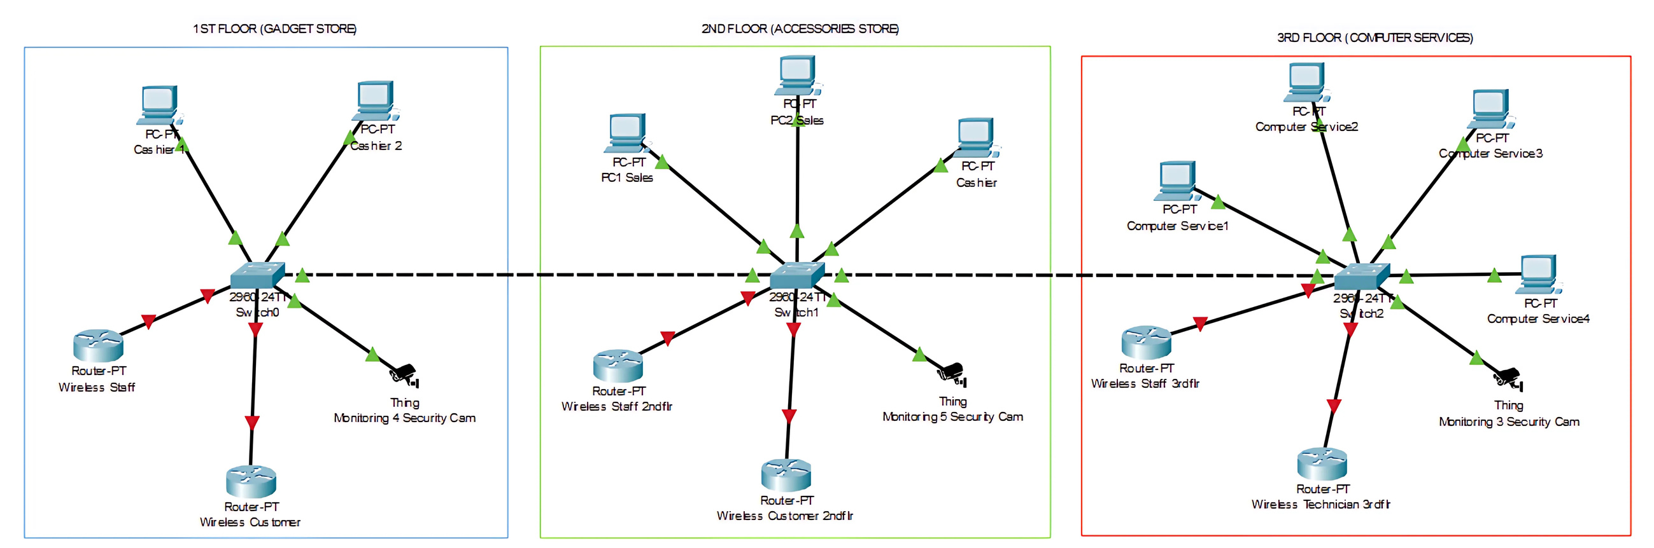
NETWORK LAYOUT
Star Topology - each section (floor) has a switch (2960 24TT) that connects all the devices on that floor. The devices (PCs, routers, and security cameras) are connected to this central switch, making it a star configuration.
Hierarchical Structure - the switches on each floor may also be interconnected, potentially creating a larger hierarchical topology.

Slide 11
THANK YOU!
BSIT-3F
GROUP 7
Viñas, Judah Paulo L. Bayrante, Reb G. Cordez, Roland Joseph P. Nodado, Mark Aratia, Jhoben S.

